Slide 1
CSS 497 2018 Capstone Genetic Algorithmic Networks
Danny Ly
Advisor: Dong Si
Computer Science and Software Engineering

Slide 2

Motivation
Goal since admissions to CS at UWB to get closer to working with Artificial Intelligence
Relevance: Bigger step towards my career goals in Machine learning

Slide 3
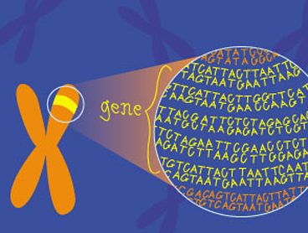
Purpose
Explore what ‘genetic algorithms’ meant
Apply their use to a practical real-world problem
Combing Neural Network’s, Reinforcement Learning, and Genetic Algorithms

Slide 4
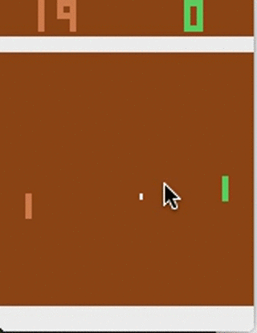
Problem
Given an interface to send keys (up, down, none) to a program, can this program learn to play ping pong adequately, based off rewards?

Slide 5
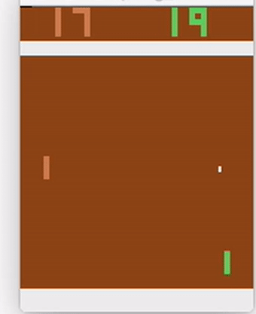
Goal
Using Genetic algorithms find the best hyper parameters that will allow this program to adequately play against another computer.

Slide 6
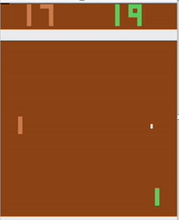
Design Approach
Pixels of the game board
Hidden Layer
Probability of Moving up, down, or not at all
Image Classification
Aims at turning on specific Neurons

Slide 7
Genetic Algorithm program flow
Initial Neural Network Population
Network Plays in their on environments
Pick Two top Performing Networks
Breed Top performers together
Combine Top Performers, their spawn, and mutated Networks into Population
Remove 50 % of population and the remaining Networks

Slide 8
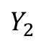
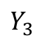
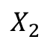
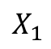
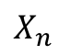
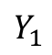
Neural Network Architecture
Input Layer
Hidden Layer
Output Layer
$$X_{1}$$
Σ
Σ
Σ
$$Y_{1}$$
$$X_{2}$$
Σ
Σ
Σ
$$Y_{2}$$
Network Outputs
Network inputs
Σ
$$Y_{3}$$
$$X_{n}$$
Σ
Σ
Neuron
Bias
1
1

Slide 9
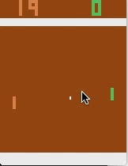
Pre-Trial Results
Green Is Network, first Model made
Model was stuck at the top or stuck at the bottom

Slide 10
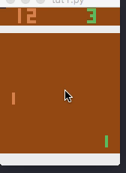
Post-Trial Result
Green is the Model playing adequately well
After changing the model to use a softmax activation function the paddle is more stable

Slide 11
Application(TO REMOVE)
Computer Gaming
Manufacturing
Robotics
Engineering Designs

Slide 12
Lessons Learned
Genetic Algorithms purpose for parameter searching
Hands on experience with machine learning data pipeline

Slide 13
Tools
Python
OpenAI Gym
GitHub
Docker
Digital Ocean
Numpy

